Slide 1


Applied Data Science Capstone Project — Strategic Clustering for Opening a Cafe in Hong Kong
Cara Lo

Slide 2
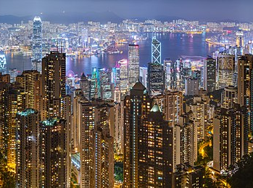
1. Introduction
Hong Kong is famous for being a ‘busy city’
Limitless choices on café
Strategic location would be vital for a great start of a new cafe
This Photo by Unknown Author is licensed under CC BY-SA

Slide 3
2. Data
The following data is used to reach the solution:
1. List of districts in Hong Kong (Source: HK GeoSpatial Open Data)
2. Population of districts (Source: Census and Statistics Department)
3. Latitude and longitude of districts (Source: HK GeoSpatial Open Data)
4. Median monthly household income of districts (Source: Census and Statistics Department)
5. Venue data (Source: Foursquare API)

Slide 4
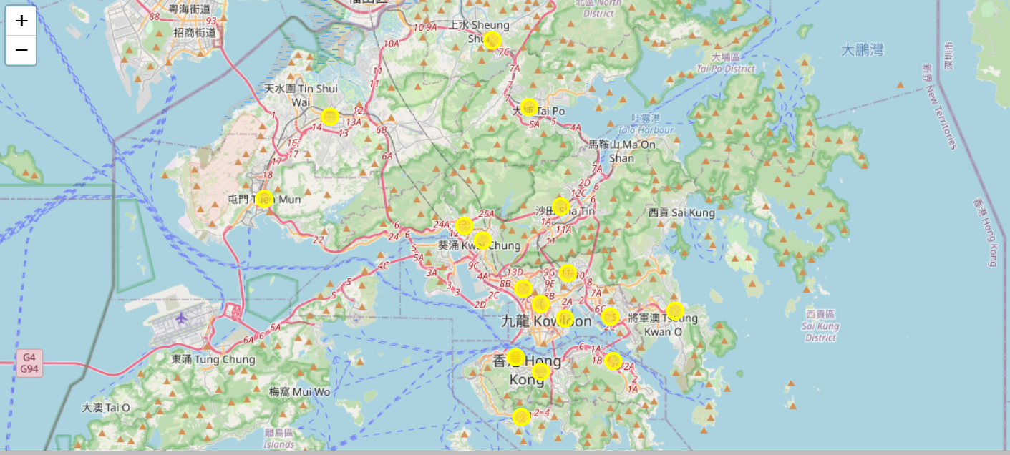
3. Methodology - 3.1 Folium Map

Slide 5
3.2 Foursquare API
Foursquare API allows us to explore different venues, including restaurants, shopping malls and hotels etc. in each district. We are able to find out the number of cafés in each district by using Foursquare API.

Slide 6
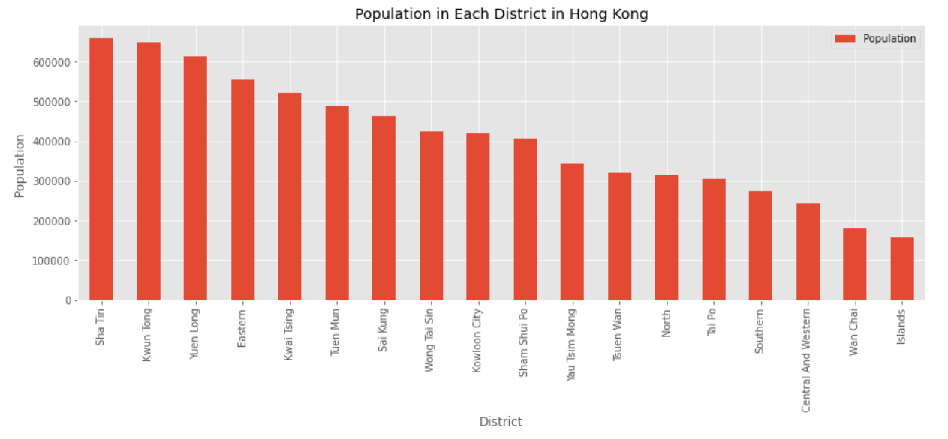
3.3 Bar Graph

Slide 7
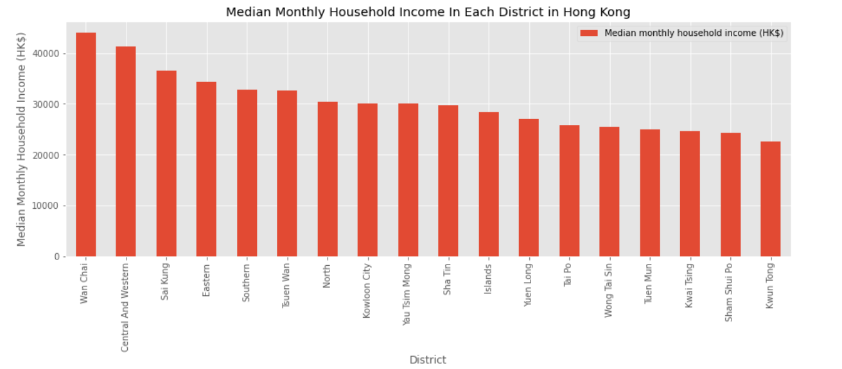
3.3 Bar Graph

Slide 8
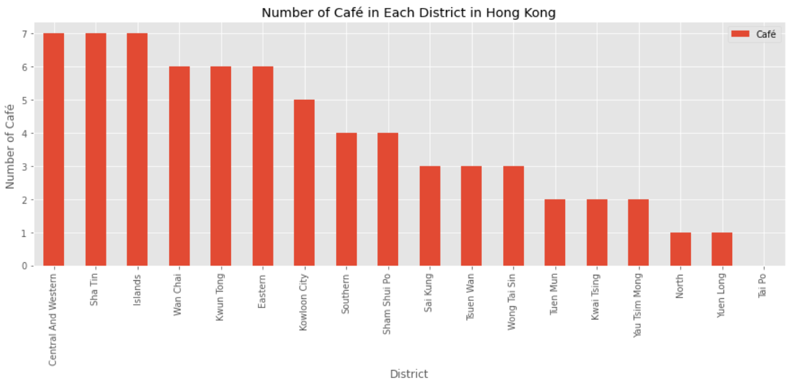
3.3 Bar Graph

Slide 9
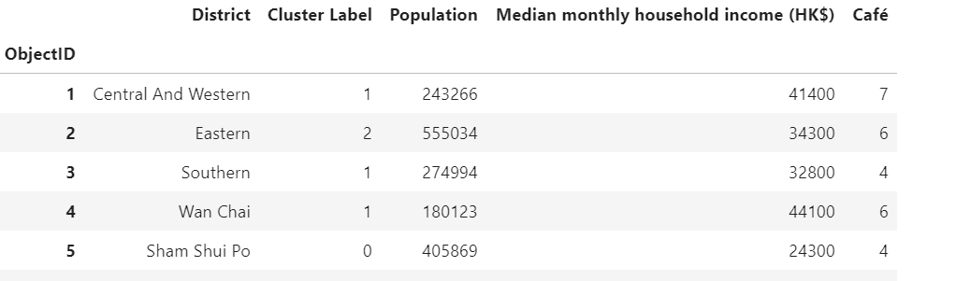
3.4 K-Means Clustering
K-means clustering, a machine learning algorithm used to create K clusters of data points based on feature similarity. In this project, the number of clusters is set to 3. Each district is then assigned with a cluster Label representing the cluster number (either 0 or 1 or 2).

Slide 10
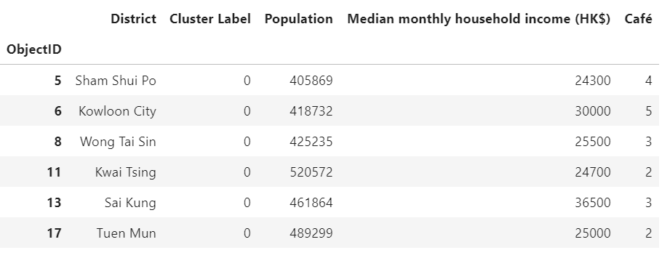
4. Results
Cluster Label 0
Med-Low Population
Low Household Income
Low Number Of Cafes

Slide 11
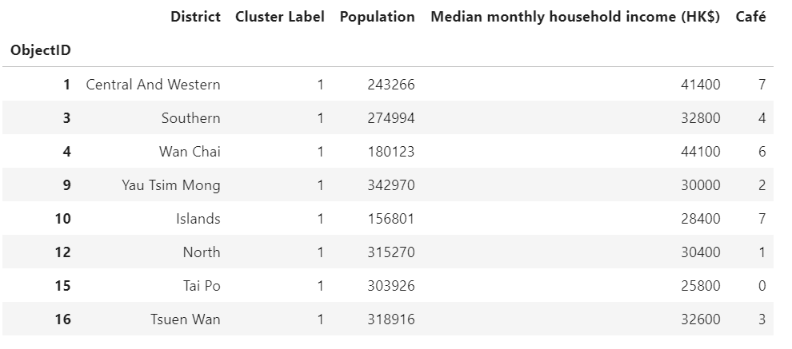
4. Results
Cluster Label 1
Med-Low Population
High-Med Household Income
High-Med Number Of Cafes

Slide 12
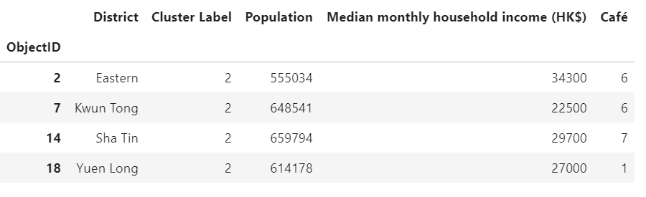
4. Results
Cluster Label 2
High Population
Med-Low Household Income
Med Number Of Cafes

Slide 13
5. Recommendation & Conclusion
Factors includes size of customer base, spending power and number of competitors
Districts in cluster label 2 are recommended
Eastern, Kwun Tong, Sha Tin and Yuen Long
A large population, a moderate income and not many competitors
Suitable for a new business to start

